Slide 1

Battle of Neighborhoods Indian Restaurant in NY
P Sakthivel

Slide 2
Opening restaurant at correct location is job half completed
There are lots of restaurants in New York, hence opening restaurants in locations that are already crowded with established restaurants with good ratings will not make sense
We will be particularly interested in areas with least Indian restaurants or with least ratings
The Indian population in New York City is over 650,000. Indians, the second largest Asian group in the city, comprised 20.5 percent of the Asian population. By borough, 65 percent of Indian New Yorkers lived in Queens, 12 percent in Manhattan, 12 percent in Brooklyn, 6.5 percent in the Bronx, and 5 percent in Staten Island
Hence the data should be sliced and diced so, we don’t end up in opening restaurant based on a single criteria

Slide 3
Data collection and cleaning
Based on our Business problem, the following factors will influence the decision making:
All existing Indian restaurants in the neighborhood
Ratings of the current Indian restaurants in various neighborhoods
NYC Indian population concentration across boroughs
Following data sources was used to extract/generate the required information:
Demographics of NYC Data source: https://en.wikipedia.org/wiki/Demographics_of_New_York_City. Web scraping techniques will be used to get NYC’s population demographics from Wikipedia.
Ratings and Number of existing Indian restaurants, their type and location in every neighborhood will be obtained using Foursquare API and https://cocl.us/new_york_dataset.

Slide 4
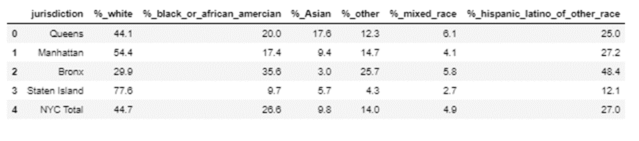
The demographic divide
Beautiful soup (html parser) was used to parse the Wikipedia page on demographics of NYC. Data wrangling is performed on the dataset for converting the raw data.
This table gives a fair idea of population demographic of NY

Slide 5
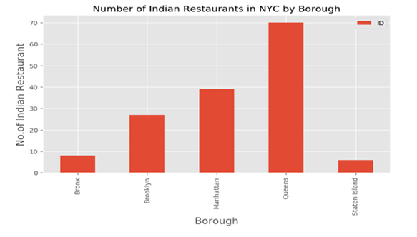
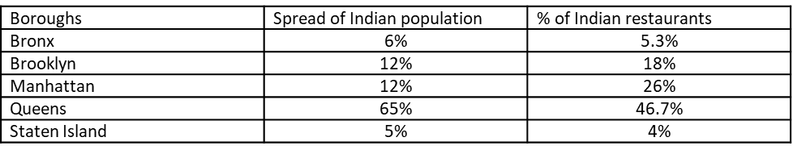
Slicing and dicing data
Inference 1: All Boroughs have a nearly equal % of Indian restaurants corresponding to the spread of Indian population except for Queens borough which has significantly lower % of Indian restaurants

Slide 6
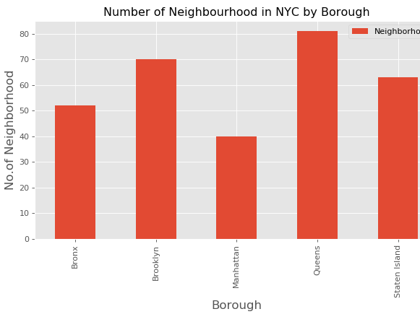
Substantiation of Inference 1
Inference 2: The lower % of Indian restaurants corresponding to the spread of Indian population in Queensborough (Inference 1) is significant since Queens has the highest number of neighborhoods by borough

Slide 7
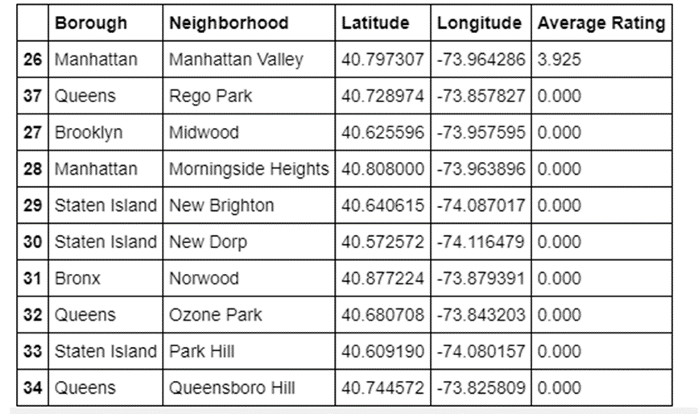
Data preparation for Visualization
As explained in the analytic approach section, our area of focus would be the neighborhood with the least average rating. There are two hypotheses on which the analysis is based on (These Hypothesis are not tested and are assumed to be true in this project)
Hypothesis 1: Average rating of 0 could mean either the restaurant was started newly, or the ratings were very low
Hypothesis 2: A newly started restaurant with low or no ratings need not be considered as competition
Based on these Hypothesis, the Neighborhoods are filtered based on ratings below 5. The data is then appended with the Latitude and Longitude coordinate of the Boroughs. The resultant table will look like the one shown in the figure

Slide 8
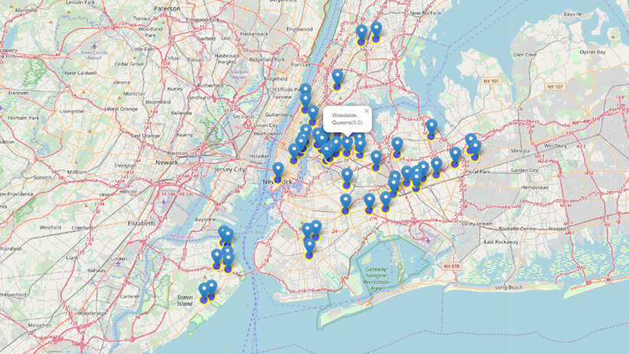
Data Visualization
Inference 3: Queensborough has the most number of neighborhoods with the least restaurant ratings

Slide 9
Results
Inf 1: All Boroughs have a nearly equal % of Indian restaurants corresponding to the spread of Indian population except for Queens borough which has significantly lower % of Indian restaurants
Inf 2: The lower % of Indian restaurants corresponding to the spread of Indian population in Queens borough is significant since Queens has the highest number of neighborhoods by borough
Inf 3: Queens borough has the most number of neighborhoods with the least restaurant ratings
From the inferences above it is evident that Queens borough will be the best place to open an Indian restaurant as it has lower % of Indian restaurants with respect to population spread, highest number of neighborhoods and the least average ratings for Indian restaurants

Slide 10
Conclusion and future directions
Further fine tuning of the model can be done to identify neighborhood level data if the hypothesis mentioned in the model are tested with primary research
This analysis is performed based on the basic premise the new restaurant opened will be a good value for money. If that goes for a toss, the new restaurant will add one more data point to restaurant with least ratings. Hence, the major contribution towards success is the value proposition that the new restaurant will offer.

